Slide 1

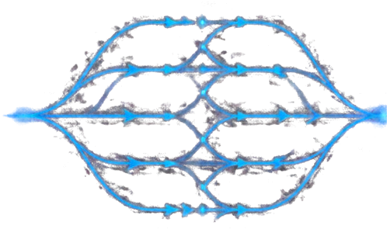




MERGE SORT
ALGORITHM
Divide. Conquer. Merge.
38
12
27
43
9
31
18
9
12
18
27
31
38
43
SUBJECT
PRESENTER
PRN :25070521193
SECTION
COLLEGE
Design and Analysis of Algorithms (DAA)
Ratisha Khadse
D
symbiosis institute of technology

Slide 2


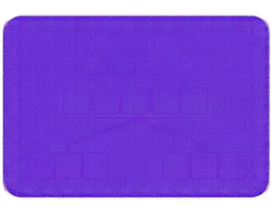

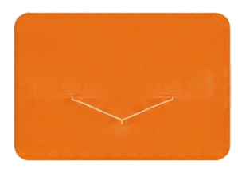


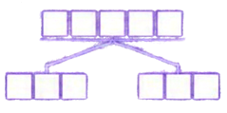


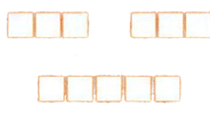







What Is
Merge Sort?
Comparison-based sorting algorithm
Uses Divide and Conquer technique
Divides array into smaller subarrays
Recursively sorts subarrays and merges them
Developed by John von Neumann in 1945
UNSORTED
ARRAY
DIVIDE
SORT SMALL PARTS
MERGE
SORTED
ARRAY
Time
Auxiliary Space
Stable
O(n log n)
O(n)
Yes
(when implemented correctly)

Slide 3

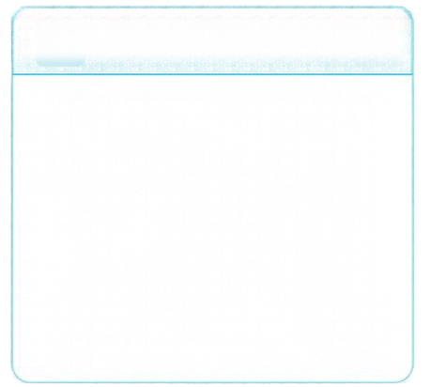


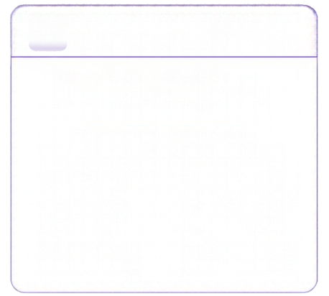


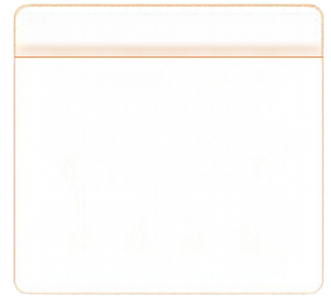


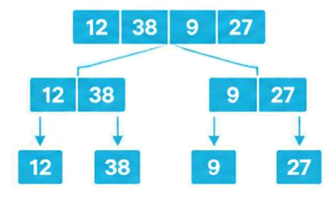


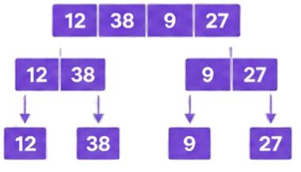
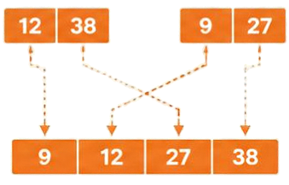





Three Steps.
One Sorted Array.
1
DIVIDE
2
CONQUER
3
MERGE
Split array repeatedly into halves
Recursively sort until
subarrays have one element
Compare first elements and choose smaller until merged
Merging
9
9 12
9 12 27
9 12 27 38
12
38
9
27
9 < 12
take 9
12 < 27
take 12
27 < 38
take 27
take remaining
38

Slide 4
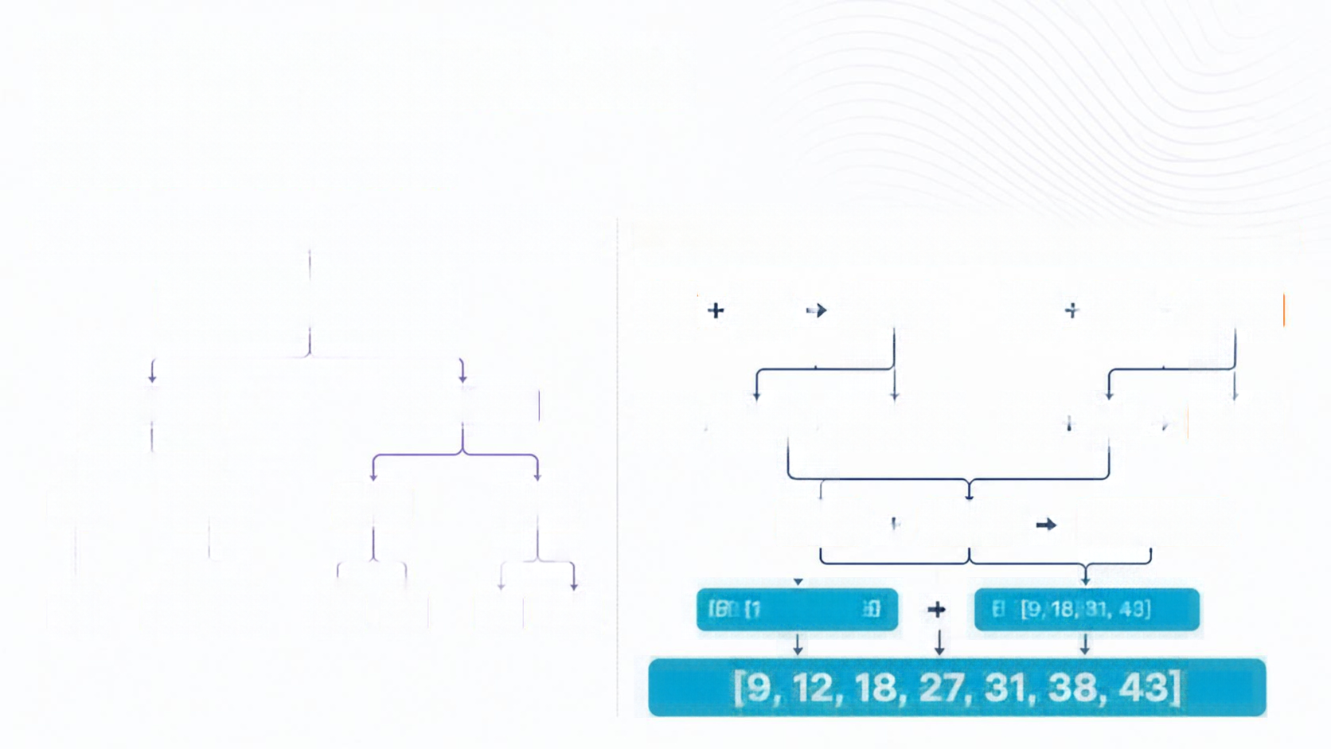








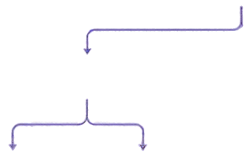



































Watch 7 Numbers
Get Sorted
DIVIDE (break down)
MERGE (combine in order)
[38, 12, 27, 43, 9, 31, 18]
[12]
[27]
[12, 27]
[31]
[18]
[18, 31]
[38, 12, 27]
[43, 9, 31, 18]
[38]
[12, 27]
[12, 27, 38]
[43]
[9]
[9, 43]
[38]
[12, 27]
[43, 9]
[31, 18]
[9, 43]
[18, 31]
[9, 18, 31, 43]
[38]
[12]
[27]
[43]
[9]
[31]
[18]
[51, 11]
[9, 18, 31, 43]
[9, 12, 18, 27, 31, 38, 43]

Slide 5















The Logic Behind Merge Sort
START
HOW MERGE WORKS
CHECK SUBARRAY SIZE
Compare elements from both sorted halves
MERGEsort(A, left, right)
01
02
03
04
05
06
07
08
09
if left < right:
Copy smaller element
into output
DIVIDE
mid = floor((left + right) / 2)
MERGE sort(A, left, mid)
Move pointer forward in the chosen half
SORT BOTH HALVES
MERGEsort(A, mid + 1, right)
Copy remaining elements after one half exhausts
MERGE(A, left, mid, right)
MERGE
BASE CASE:
A subarray with zero or one element is already sorted.
RETURN

Slide 6
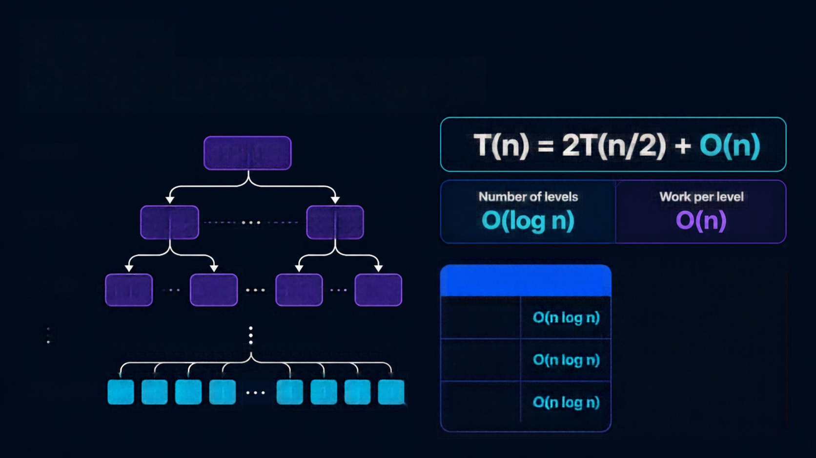



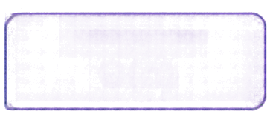


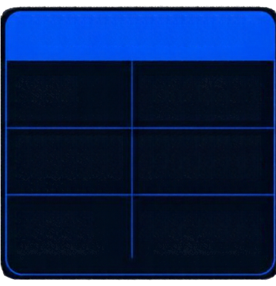














Why Is
Merge Sort O(n log n)?
Level 0
n
Number of levels
Work per level
Level 1
n/2
n/2
Level 2
n/4
n/4
n/4
n/4
TIME COMPLEXITY
SPACE COMPLEXITY
Best
O(n log n)
Temporary arrays
O(n)
Recursion stack
O(log n)
Average
O(n log n)
Level log₂ n
1
1
1
1
1
1
1
1
Overall auxiliary space
O(n)
Worst
O(n log n)

Slide 7





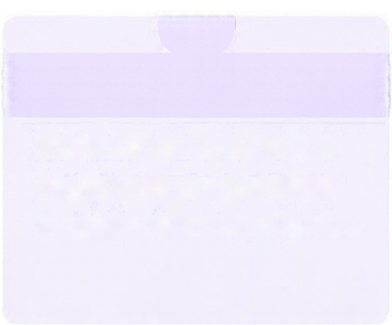
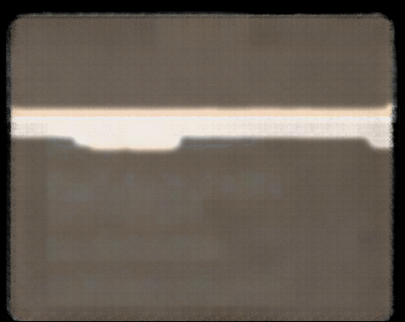





Where Does
Merge Sort Stand?
ADVANTAGES
DISADVANTAGES
APPLICATIONS
Guaranteed O(n log n) time
Stable sorting
Good for large datasets
Effective for linked lists
Requires O(n) extra array space
Copying and memory overhead
Less efficient for very small arrays
Sorting large datasets
External sorting for data
exceeding RAM
Sorting linked lists
Stable sorting of records
Merge Sort
Quick Sort
Heap Sort
O(n log n) worst case,
stable, O(n) auxiliary space
O(n log n) average,
O(n²) worst case,
typically in-place
O(n log n) worst case,
O(1) auxiliary space iterative

Slide 8
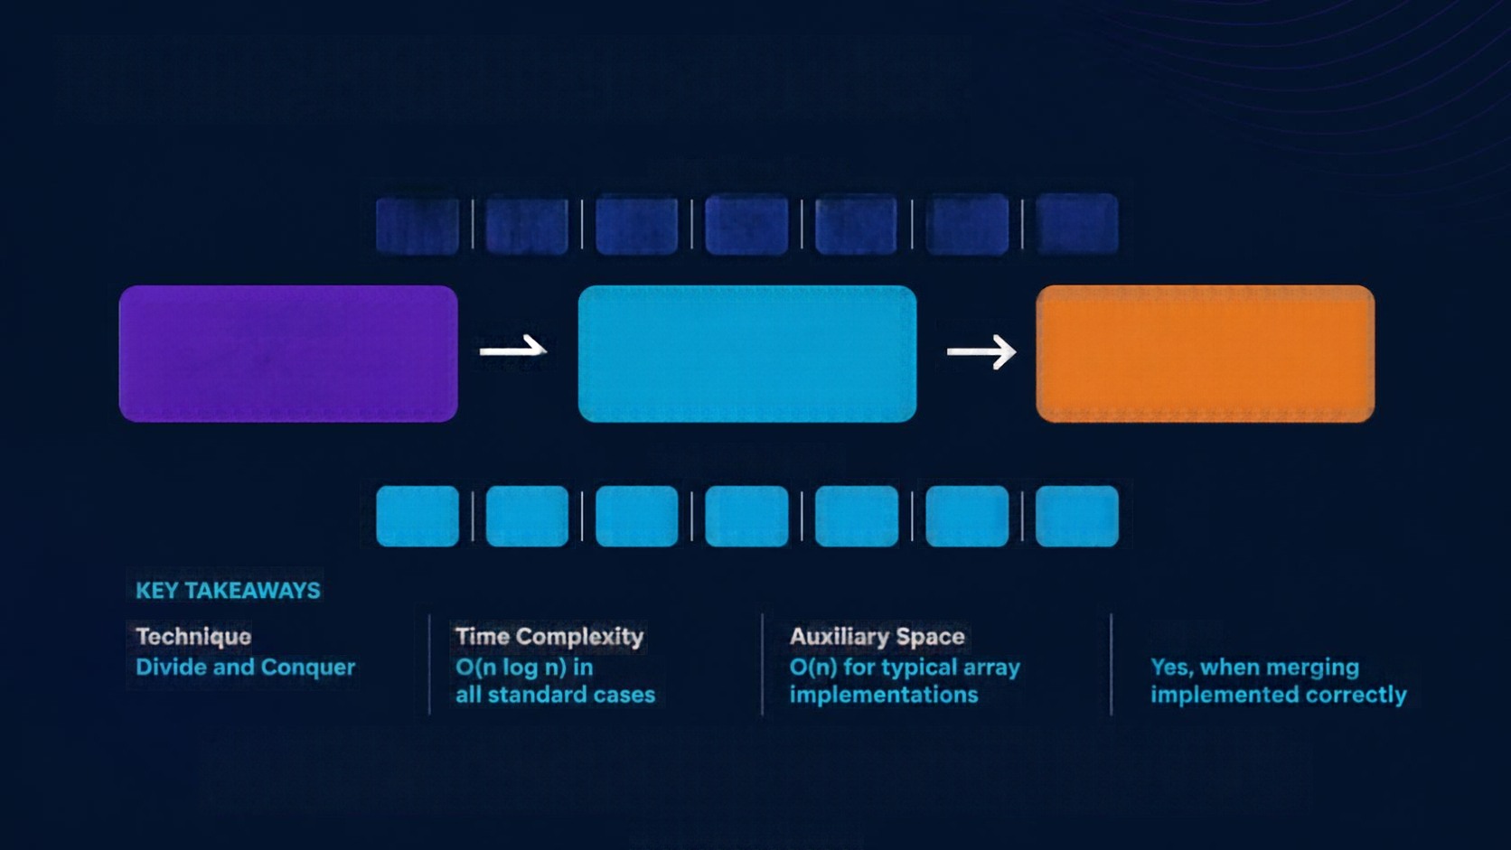









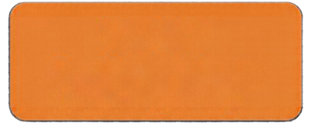











From Chaos to Order
ORIGINAL ARRAY
38
12
27
43
9
31
18
DIVIDE
CONQUER
MERGE
Break the array into smaller parts
Recursively sort
the subarrays
Combine sorted parts into a single array
SORTED ARRAY
9
12
18
27
31
38
43
Stable
“Divide the problem, solve the smaller parts, and merge the results.”
Generated using Canva AI

